Slide 1
SMART NETWORK SYSTEMS (SNS)
MURTALA IBRAHIM KANKAROFI
ELECTRICAL AND ELECTRONICS ENGINEER
CENTER OF EXCELLENCE (CYENS)

Slide 2
SMART NETWORKS
Computing networks with intelligence
IOT (Internet of things):
a. Things/Devices
b. Communication Technologies
c. Gateways
d. Data Analysis
e. User Interface
Resilient Computer Network:
a. Defend
b. Detect
c. Remediate
d. Recover
e. Diagnose
f. Refine

Slide 3
Python is the best language to use
Why python is used:
Easy to learn and use
Job opportunities
Object-oriented program characteristics
Open source
Applications with built-in solutions
Data analysis tool
Machine learning tool
Flexibility and reliability
Convenient for web development
Internet of things(I0T)

Slide 4
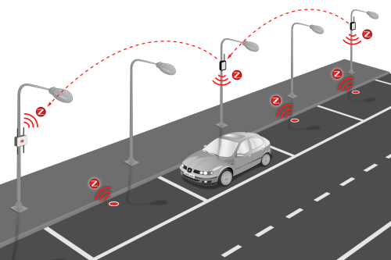
SMART PARKING
BENEFITS
Smart Parking https://www.google.com/search?q=smart+parking&sxsrf=ALiCzsZaORAgsGiRCvkcURnyDHG7mYLj-Q:1662492224224&source=lnms&tbm=isch&sa=X&ved=2ahUKEwiN0d2T8oD6AhWAQEEAHW6IAvoQ_AUoAXoECAIQAw&biw=1920&bih=929&dpr=1#imgrc=ZSi3rT0lsWlfyM
Reduced Traffic
Safety Improvement
Reduced Operational Costs
Reduces Pollution
Enforcement Effectiveness
Smart City Development

Slide 5
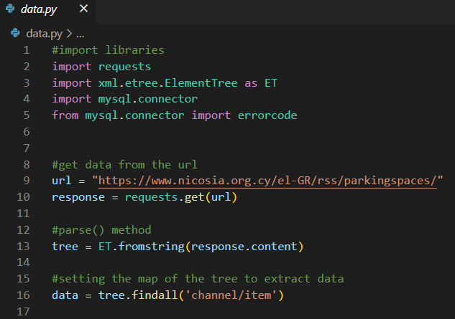
Data Extraction
Import Libraries
Get the data
Parse the data

Slide 6
Problems on gathering the data..
It took days to update data on the server
Most parking spaces didn’t get updated through out the project cycle
Delayed response from the server technicians
Unavailable to get the complete data even though formal requests were made
Attempts to find alternatives
Delayed the project

Slide 7
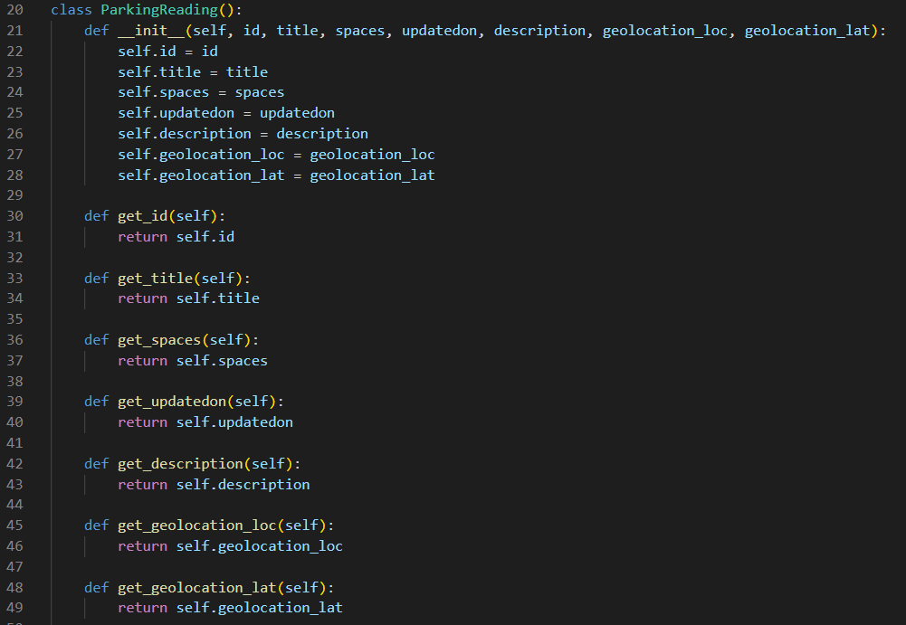
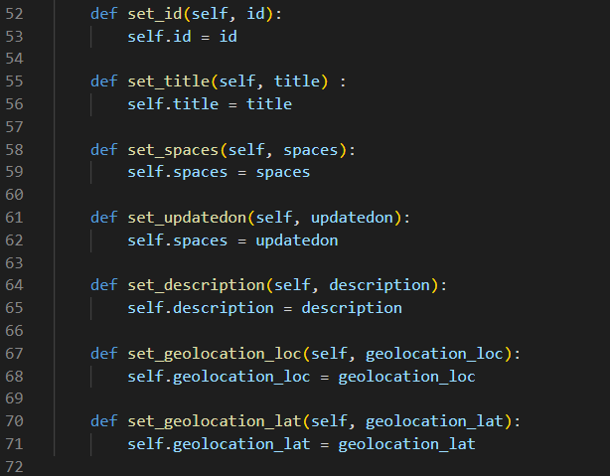
Blueprint for data Extraction

Slide 8
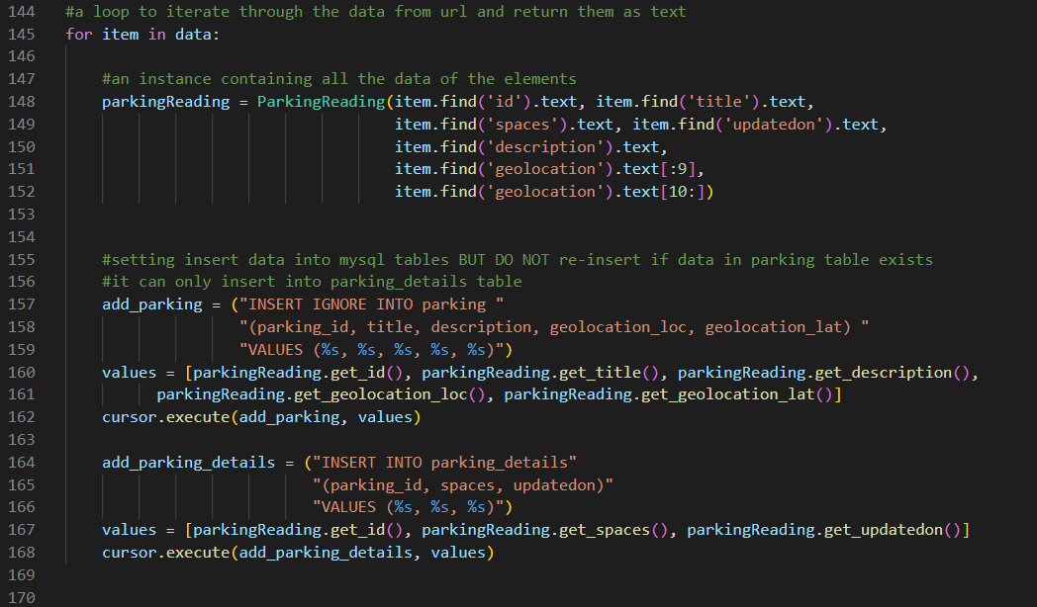
SQL Database
Data insertion to my SQL tables
Cron job

Slide 9
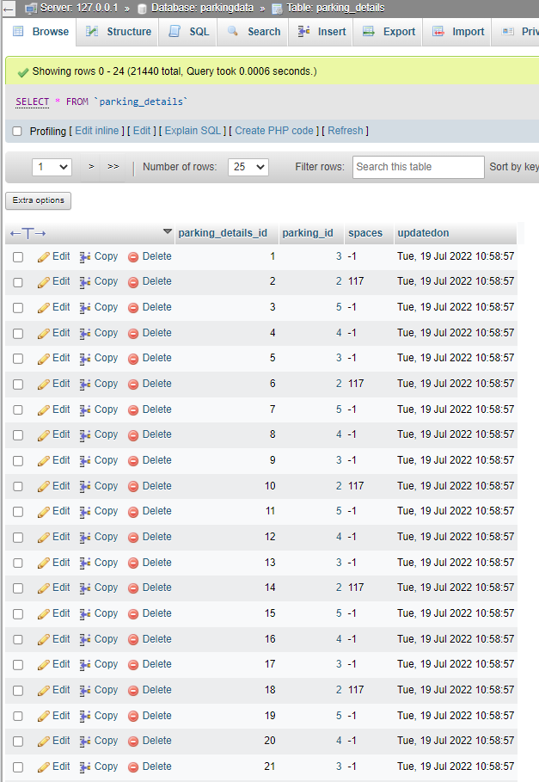
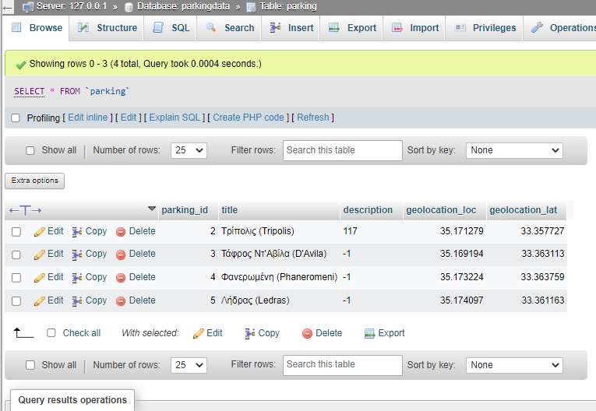
MYSQL Database
Parking table
Parking details table
Parking ID 2 used only for Model

Slide 10
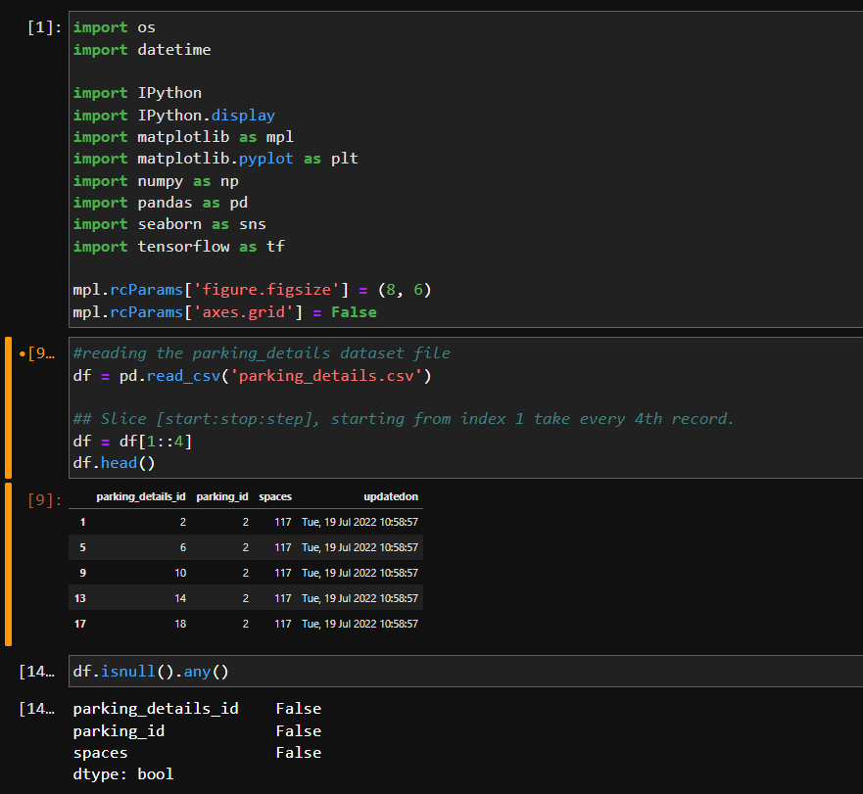
Examine Data Set And Features
Check for missing data
Remove duplicate data
Fixing Data Structure
SMOTE technique
Overfitting/underfitting
K-fold cross Validation

Slide 11
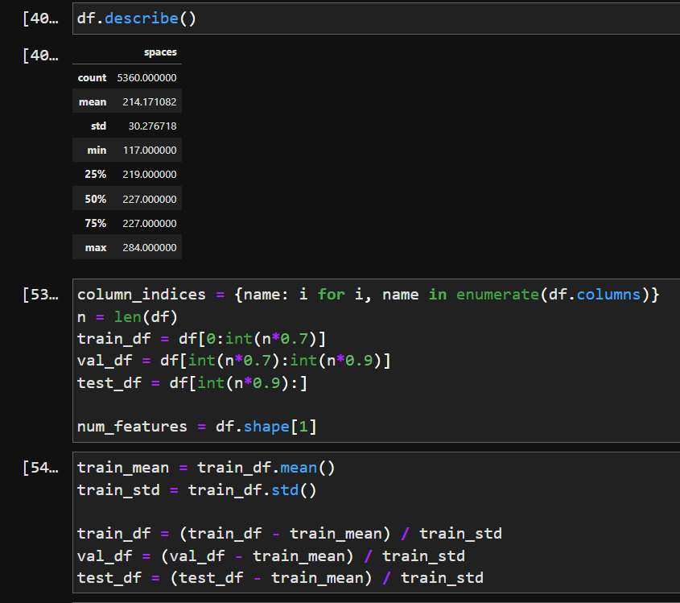
Before training a neural network, it is very important to scale the data by normalization. This process is to subtract the mean and divide by the standard deviation of each feature. The mean and standard deviation are only computed using the training data so that the models won't have access to the values validation and test results. This method ensures to get an honest matrices.
Next, we split the data. You will use a (70%, 20%, 10%) split for the training, validation, and tests set.

Slide 12
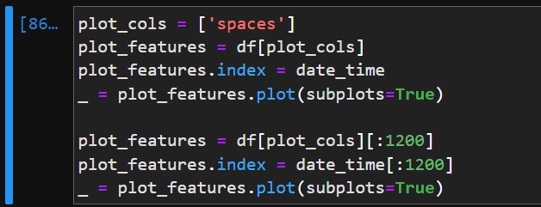
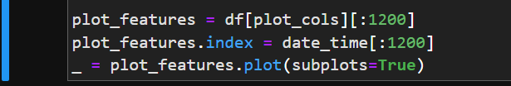
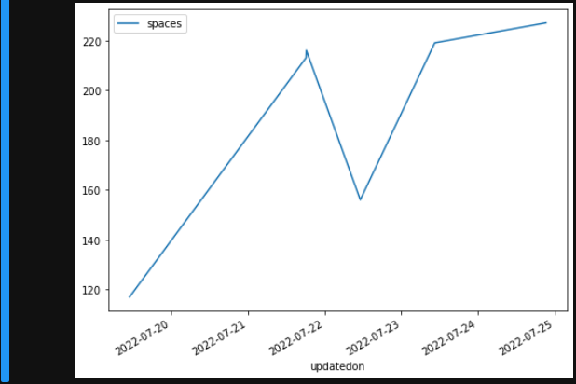
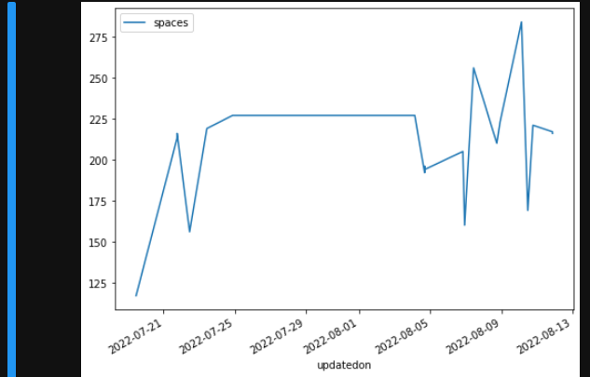
PLOT
Spaces Plot evolution with respect to time

Slide 13
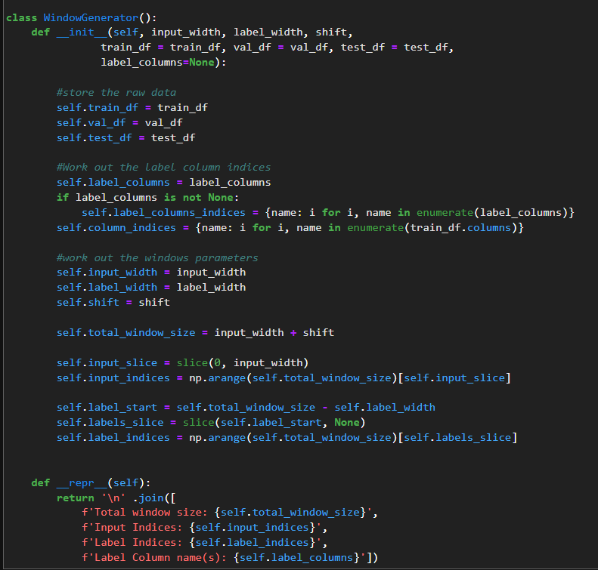
LSTM MODEL
Window generator
In this category, we will apply data windowing. Data windowing will make a set of predictions based on as window of consecutive samples of the data. The main features of the input windows are the width, offset, and the features use as inputs, labels or both. This can be used to build a variety of CNN, DNN and RNN models for (single-output and multi-output predictions) and (single-time step and multi-time step predictions)

Slide 14
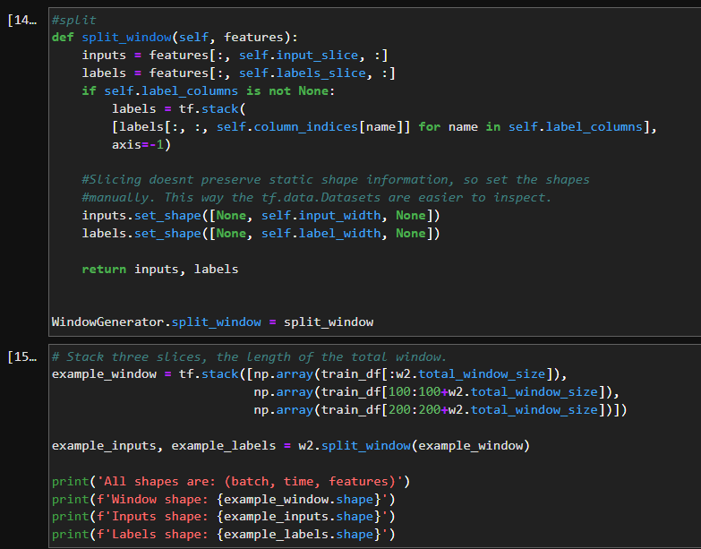
LSTM MODEL
Split Window
Given a list of consecutive inputs, the split window method will convert them to a window of inputs and a window of labels

Slide 15
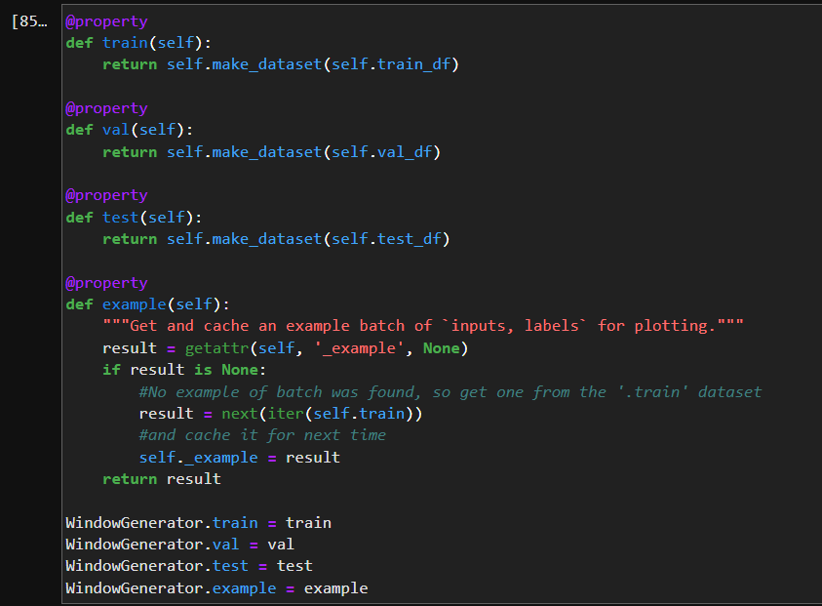
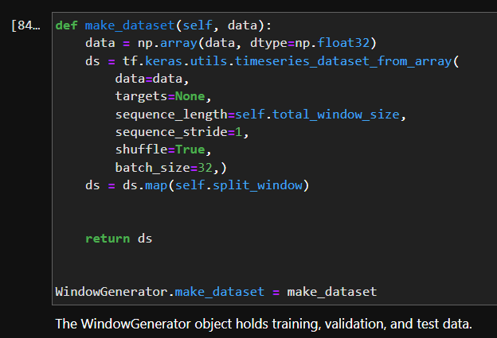
LSTM MODEL
this make dataset method will take a time series Data Frame and convert it to a tf.data.Dataset of (input_window, label window) pairs using the tf.keras.utils.timeseries_dataset_from array function
Add properties for accessing them as tf.data.Datasets using the make_dataset method you defined earlier. Also, add a standard example batch for easy access and plotting

Slide 16
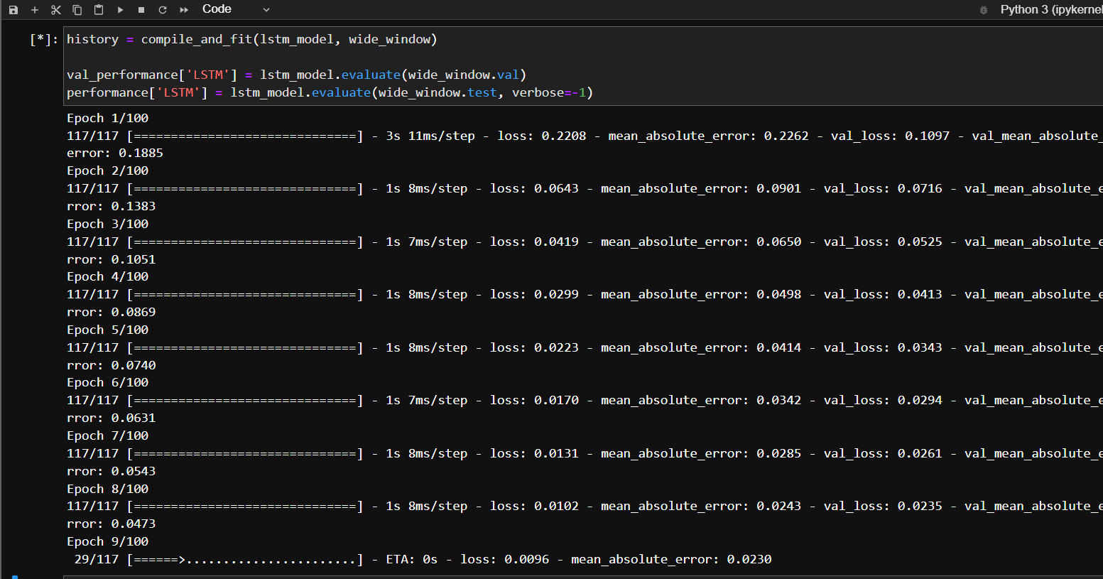
LSTM MODEL
Long short-term memory
Time series forecasting model
Greater Accuracy
Predicts future values based on previous
Better in decision making

Slide 17
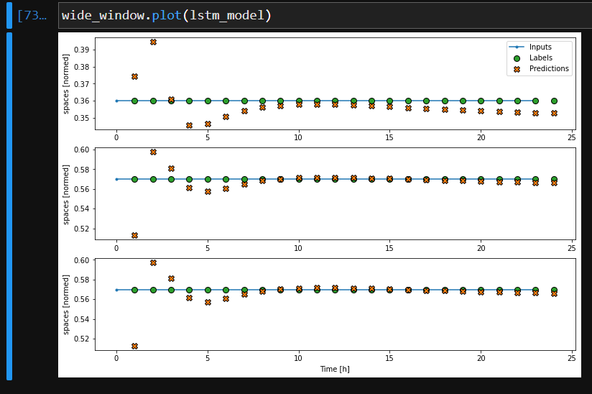
LSTM MODEL
MODEL SETUP
3,757 training examples
1,072 validation examples
536 test examples
MSE 0.96
predicts in future date (integer from 1970) the free space in the parking

Slide 18
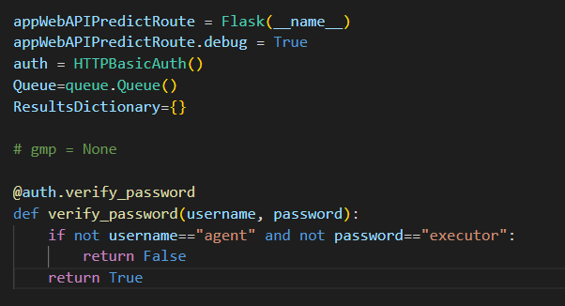


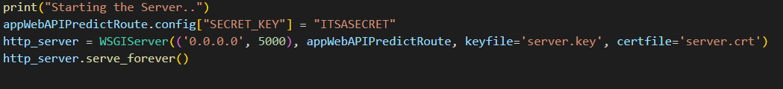
App Web API Predict Parking
For prediction using the LSTM, Data was exported from the table “parking_details” as CSV (called “dataset.csv”) from MySQL. It calculates the spaces that specific parking (with the “parking_id” feature). The service is at 5000 port

Slide 19
REST SERVICES (REST API)
Application program interface
Uses HTTP requests to access data
Uses less bandwidth
Efficiency in internet usage
RESTful API is representational state transfer
Architecture used in web development
Preferred over other similar technologies
Formats:
application/json
application/xml
application/x-www-form- urlencoded
multipart/form-data ETC
USES:
Get - reading
PUT - updating
POST - creating
DELETE - deleting

Slide 20
CONCLUSION
.
Helps in smart city development
Less fuel consumption
Time efficient
Reduced parking stress
Reduced traffic
Modern environment
The best way to benefit drivers is through smart parking systems. It is creative and ideal for addressing parking issues. The smart parking solution gives drivers a stress-free parking experience and makes it possible for them to identify open parking places nearby their destination right away.

Slide 21
Appreciation
I want to express my gratitude to Prof. Vasos Vassiliou and Prof. Iacovos Ioannou for giving me this amazing opportunity to learn and do something new which makes me feel very proud of what I have achieved. They have worked tirelessly with me through this journey. I started with no knowledge of object oriented programming but they coached me and pushed me to be from zero to hero. No words can express my appreciation towards you, yet I still say Thank you for everything.
Thank You

